Slide 1
Chapters
Improve signal acquisition from ECG shirt
State of the art QRS detectors
HRV metrics
Pan Tompkins
Christov
Hamilton
Engelse and Zeelenberg
Elgendi
Artefact correction:
Detrending
Kubios artefact correction
RR-intervals 20% deviated from the median
HRV metrics:
RMSSD, LF, HF, LF/HF
New shirt prototype
New hardware implementation

Slide 2
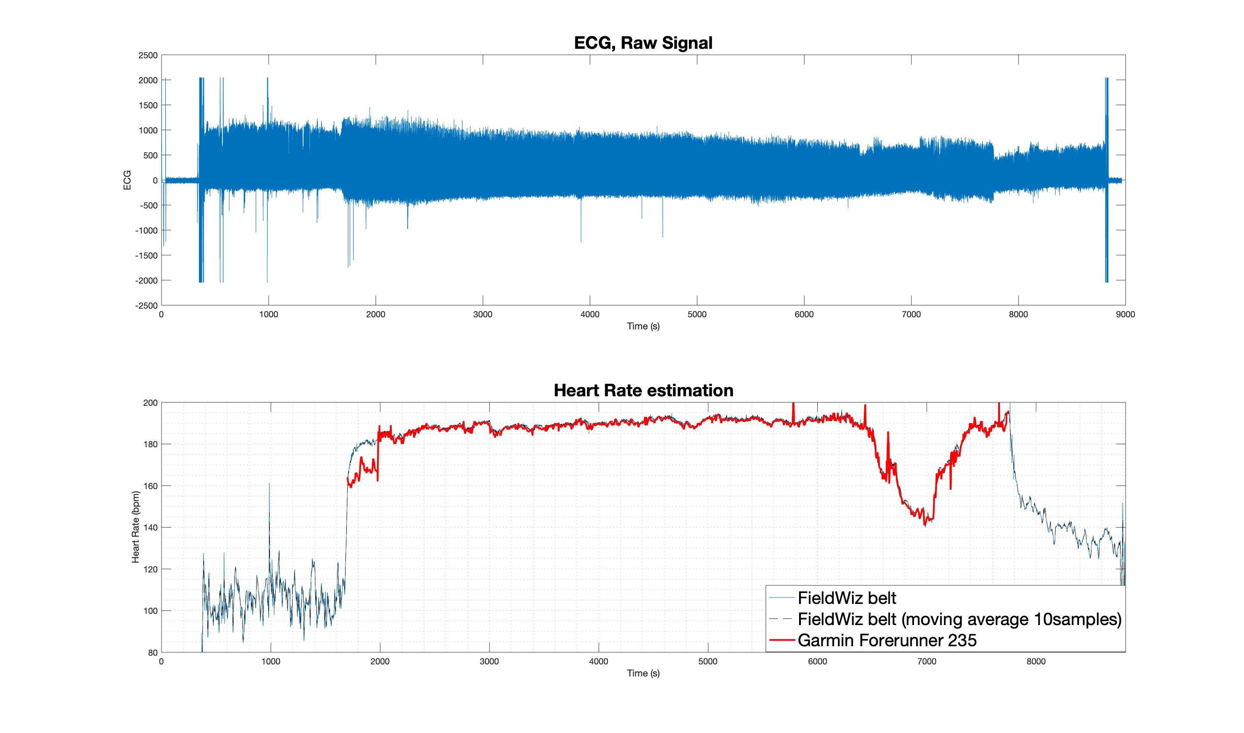
27/10/2019 Chest Strap
T_{i}
T₁
T₂
T_{f}
Lausanne Half Marathon 2019. Top) Raw ECG signal from FieldWiz chest strap; Bottom) Heart Rate estimations from 1) FieldWiz chest strap, 2) FieldWiz chest strap, 10samples moving average and 3) Garmin Forerunner 235.
T_{i}) Beginning of the Half-Marathon; T_{f}) End of the Half-Marathon; T₁) Stop running; T₂) Start running.

Slide 3
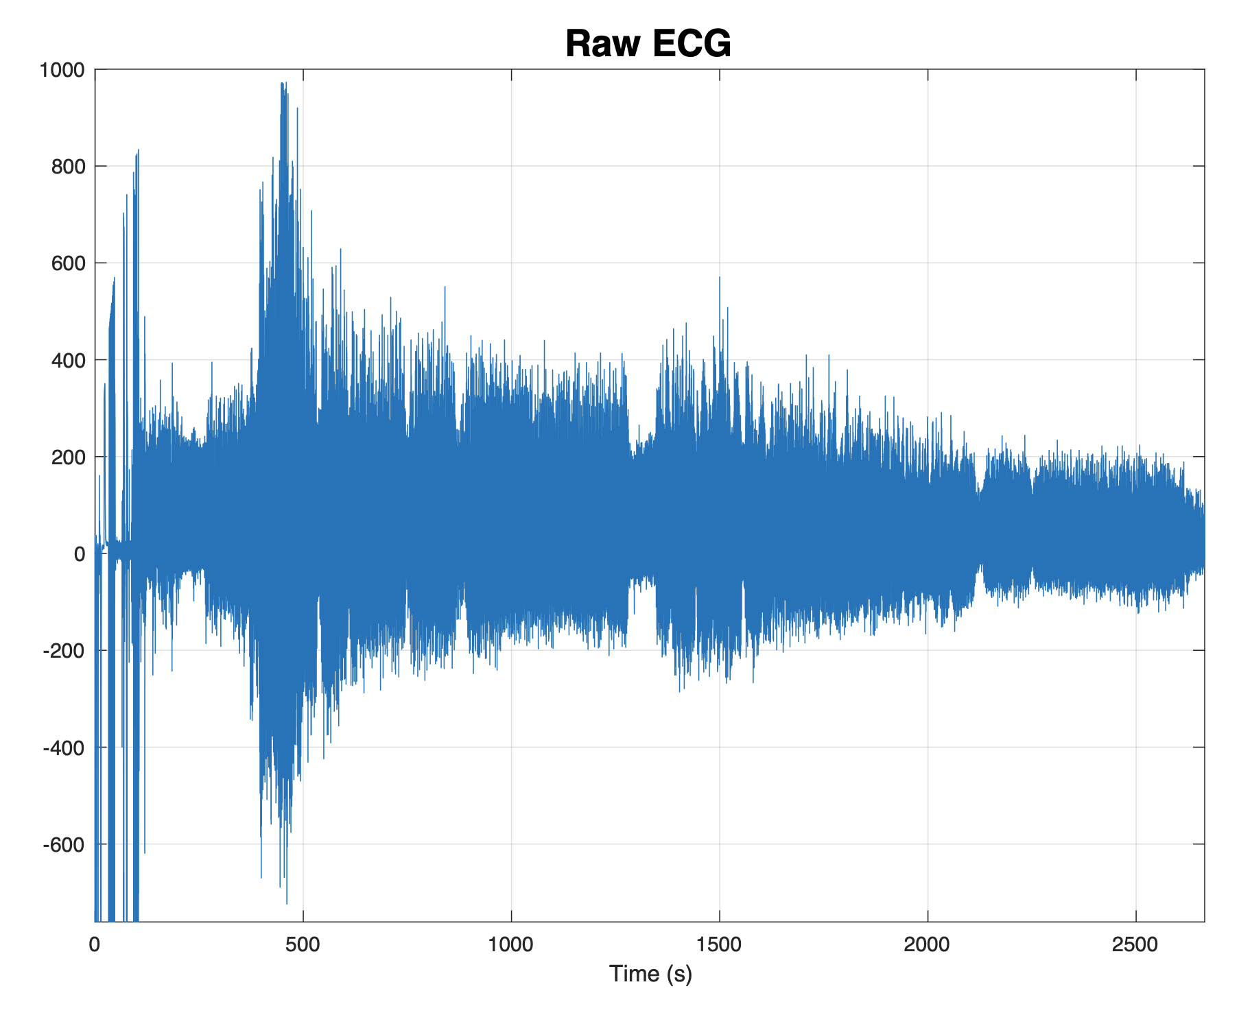
05/02/2020 T-shirt (old version)
1
2
3
4

Slide 4
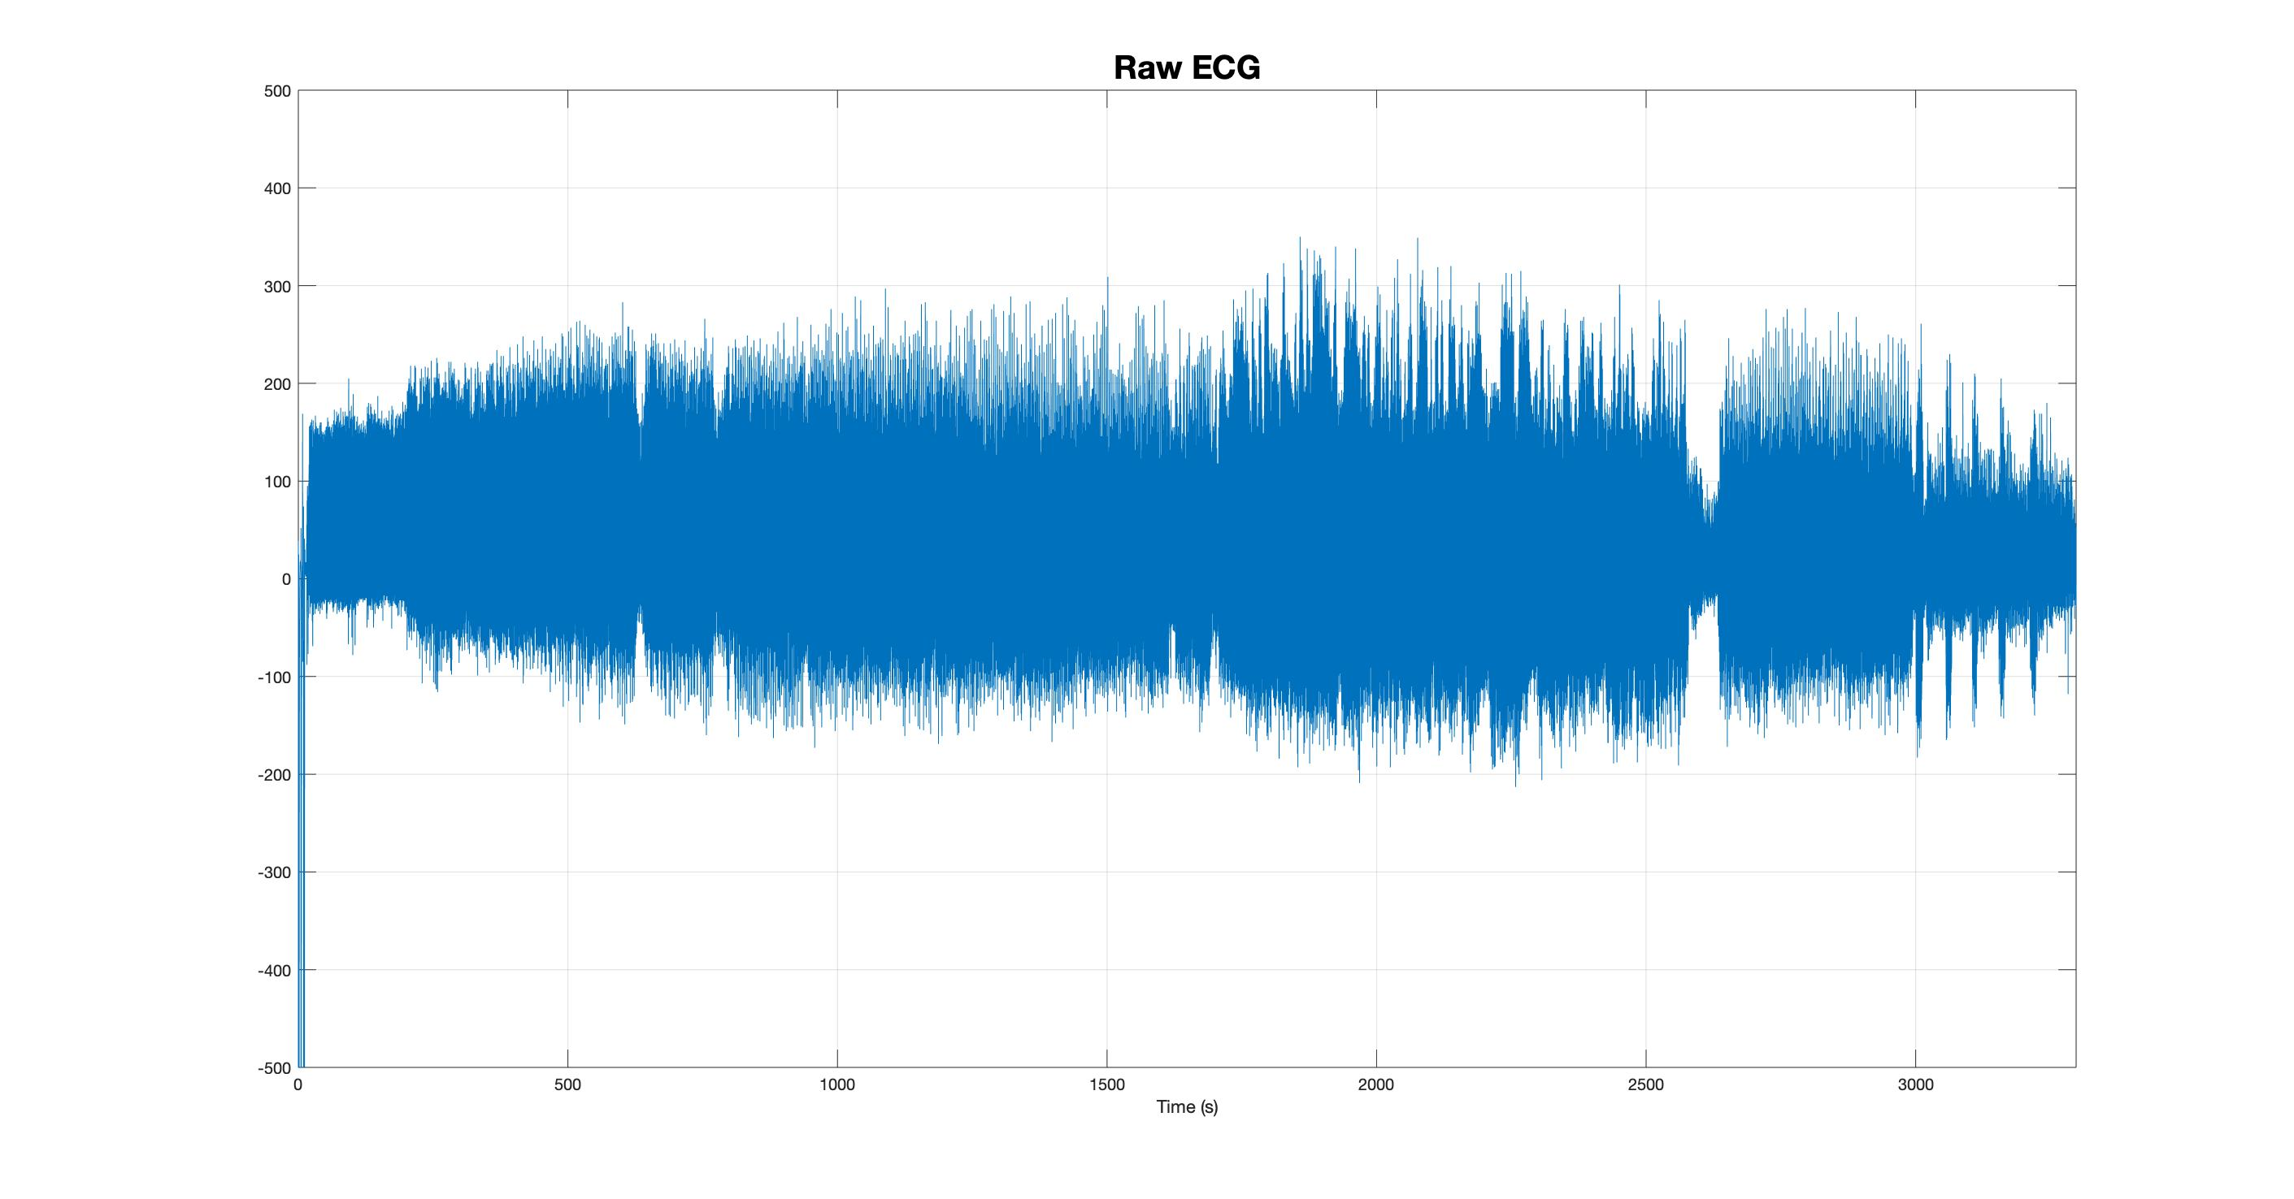
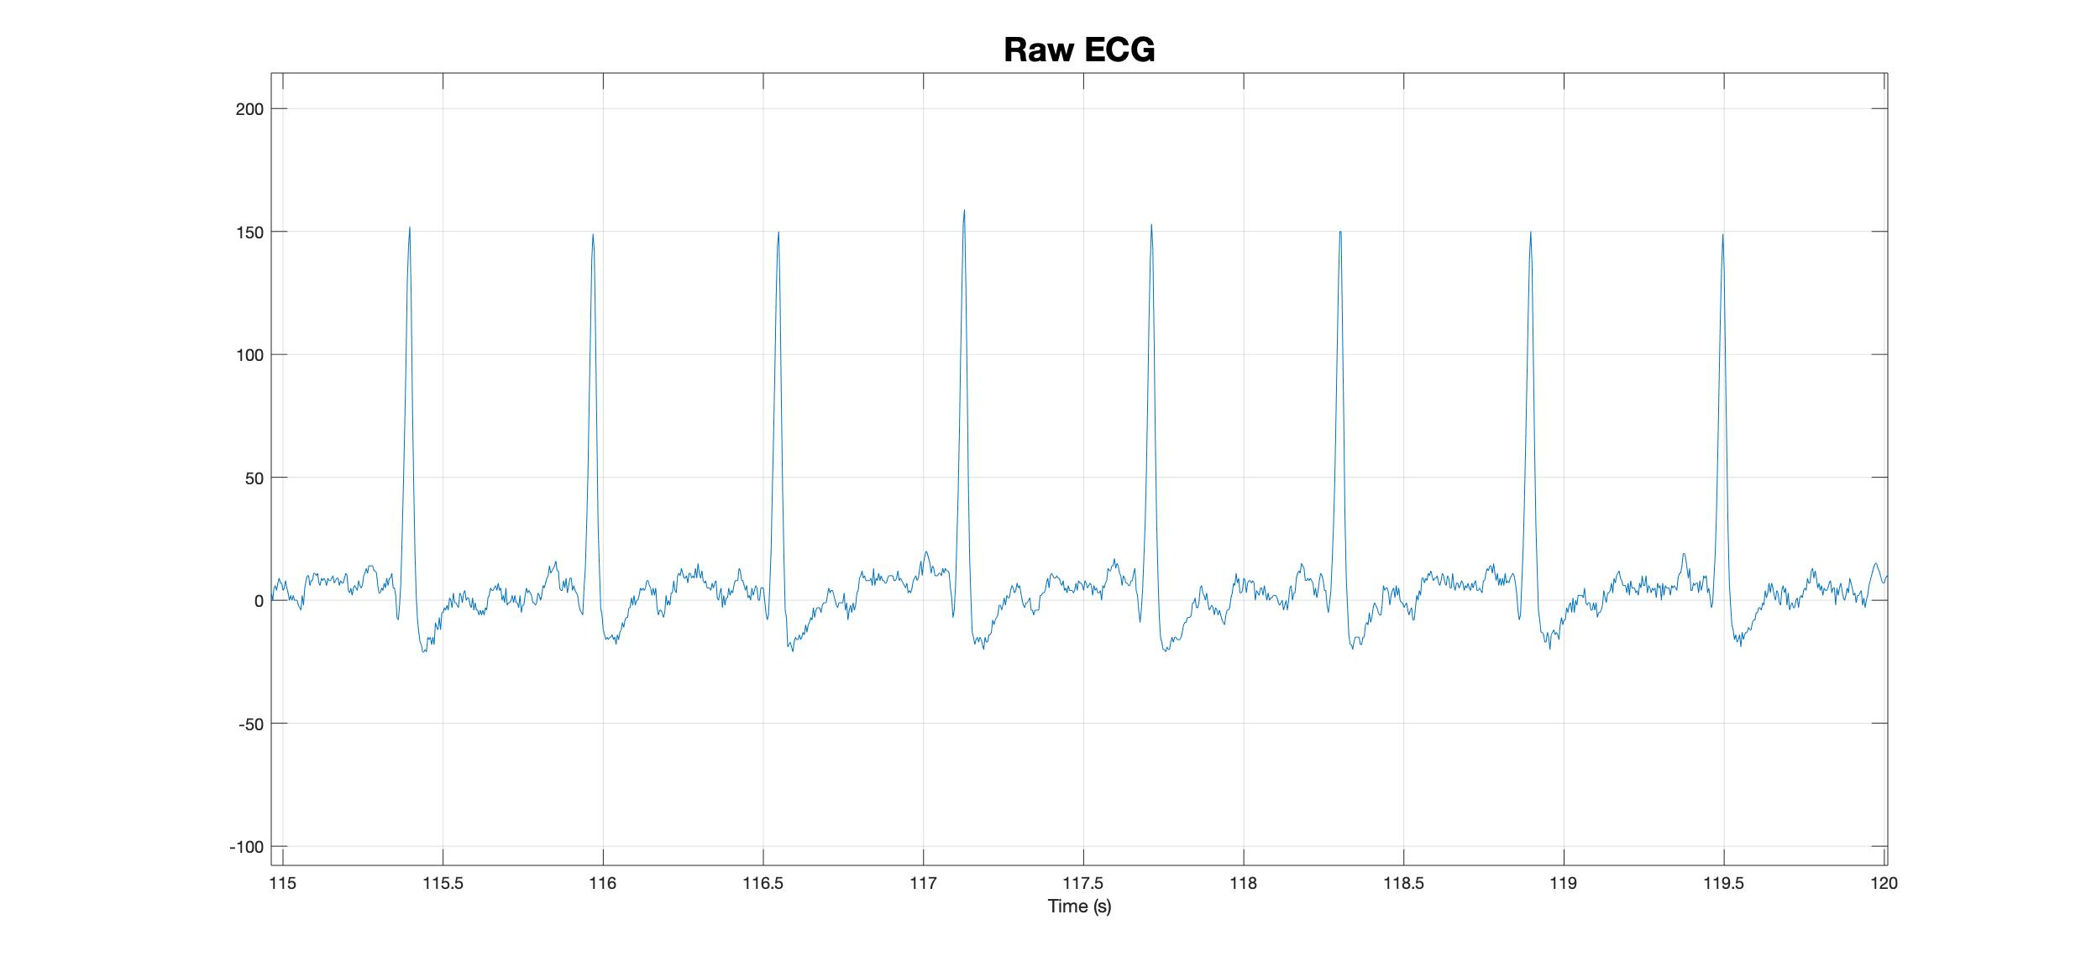
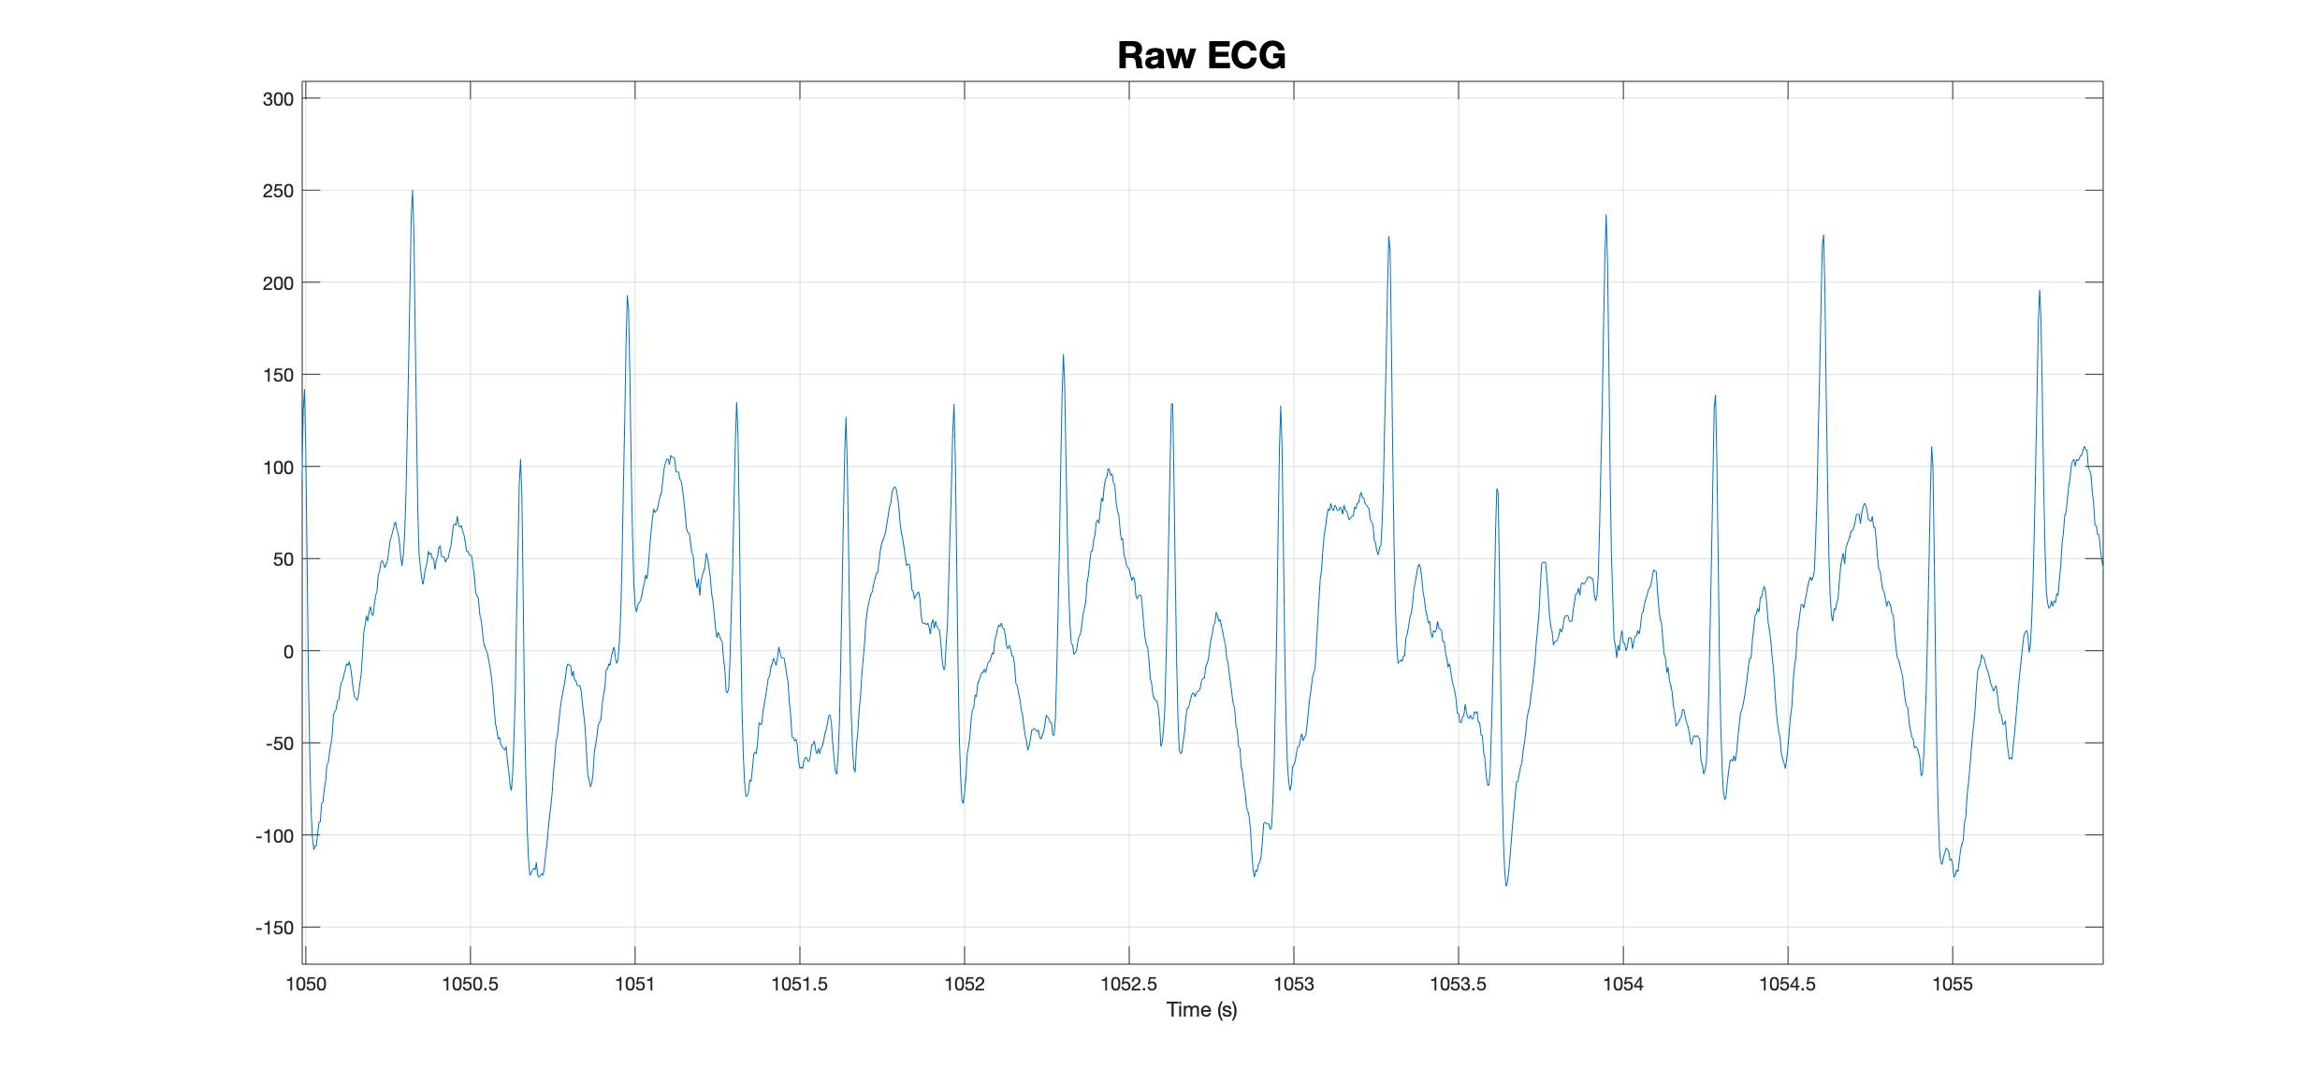
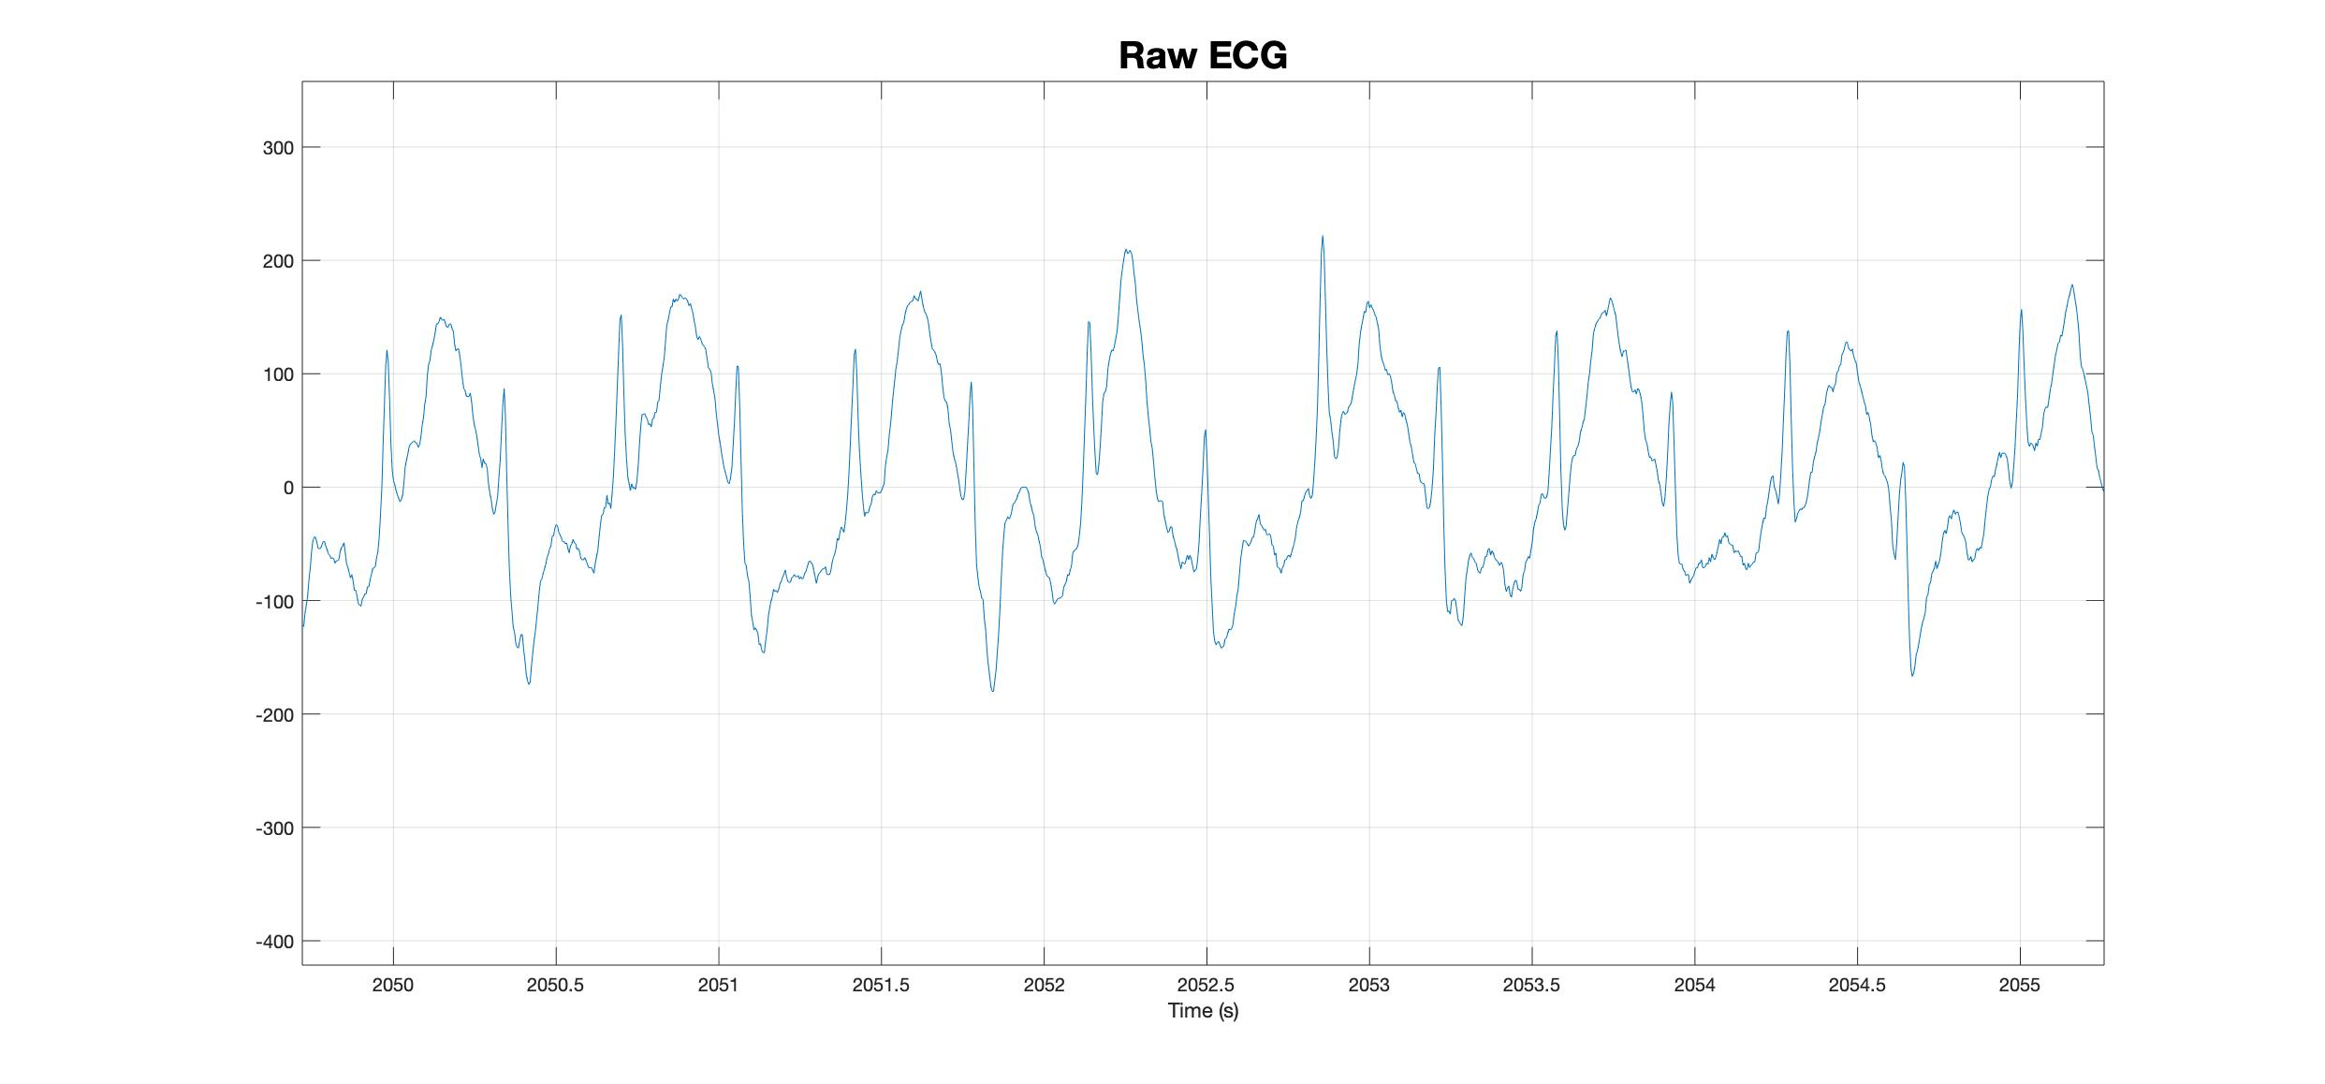
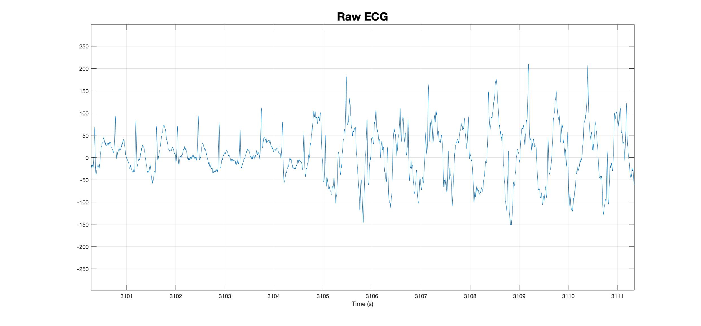
06/02/2020
1
2
3
4

Slide 5
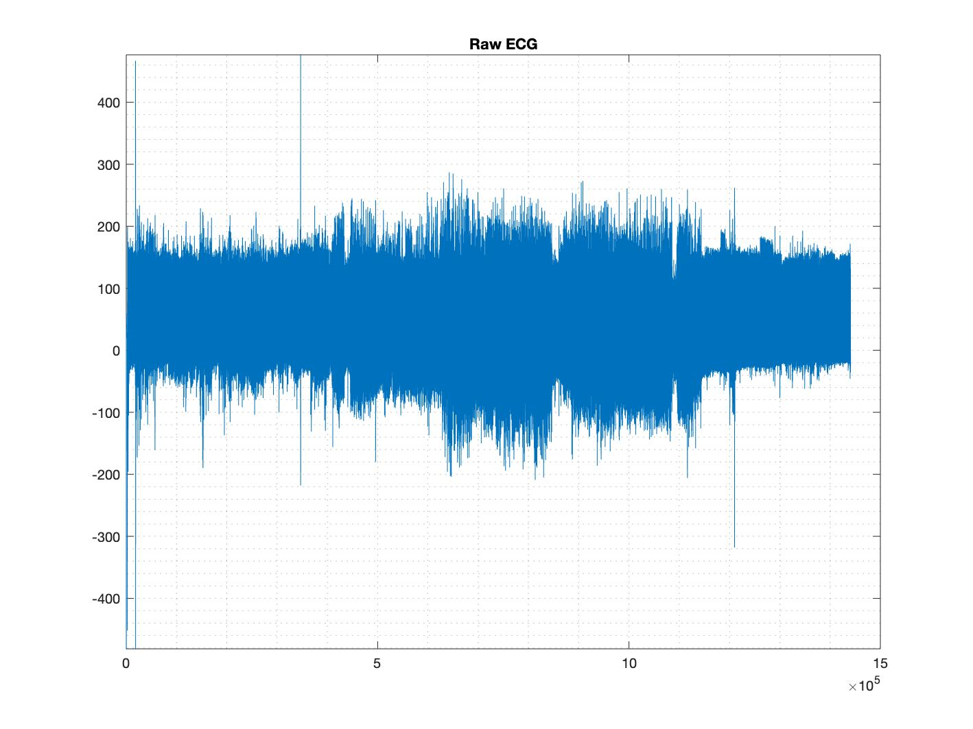
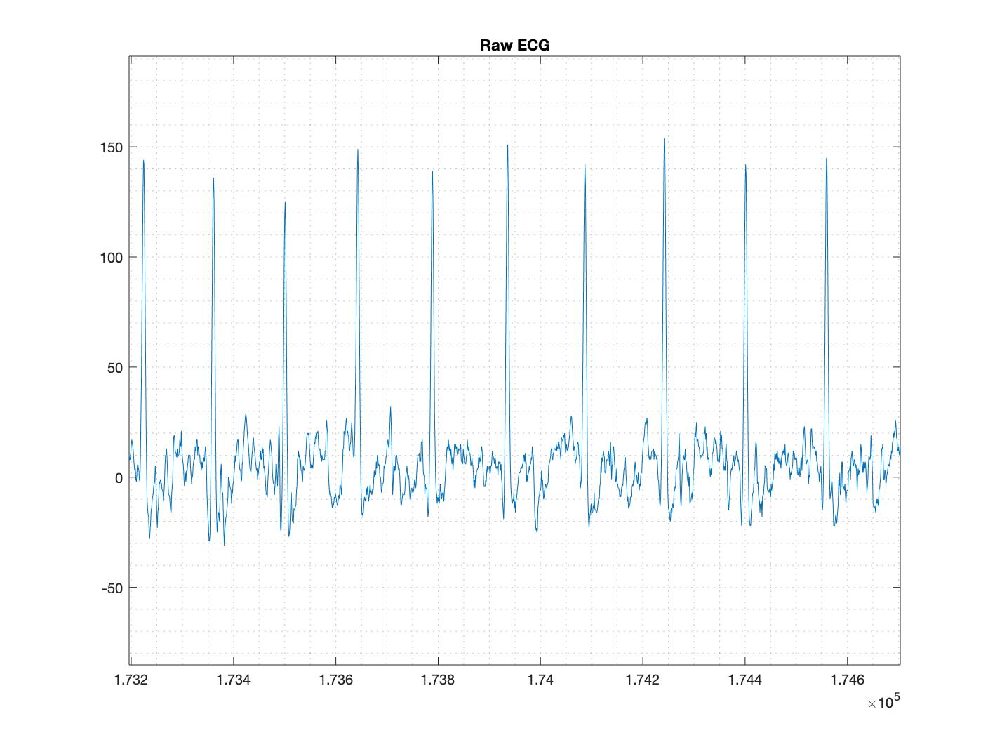
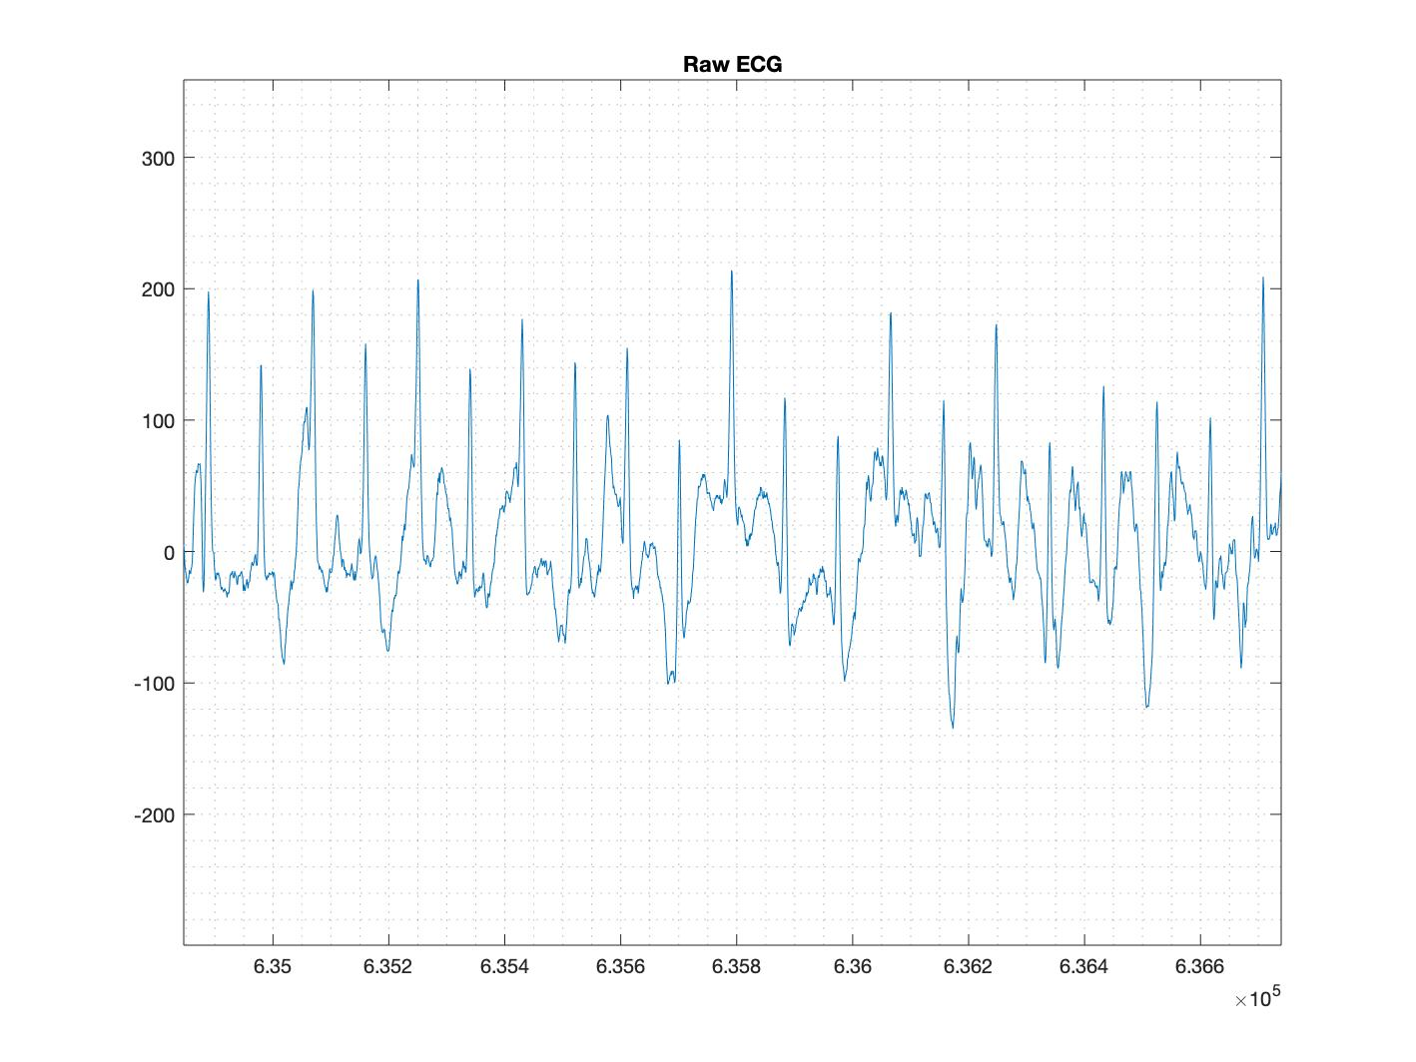
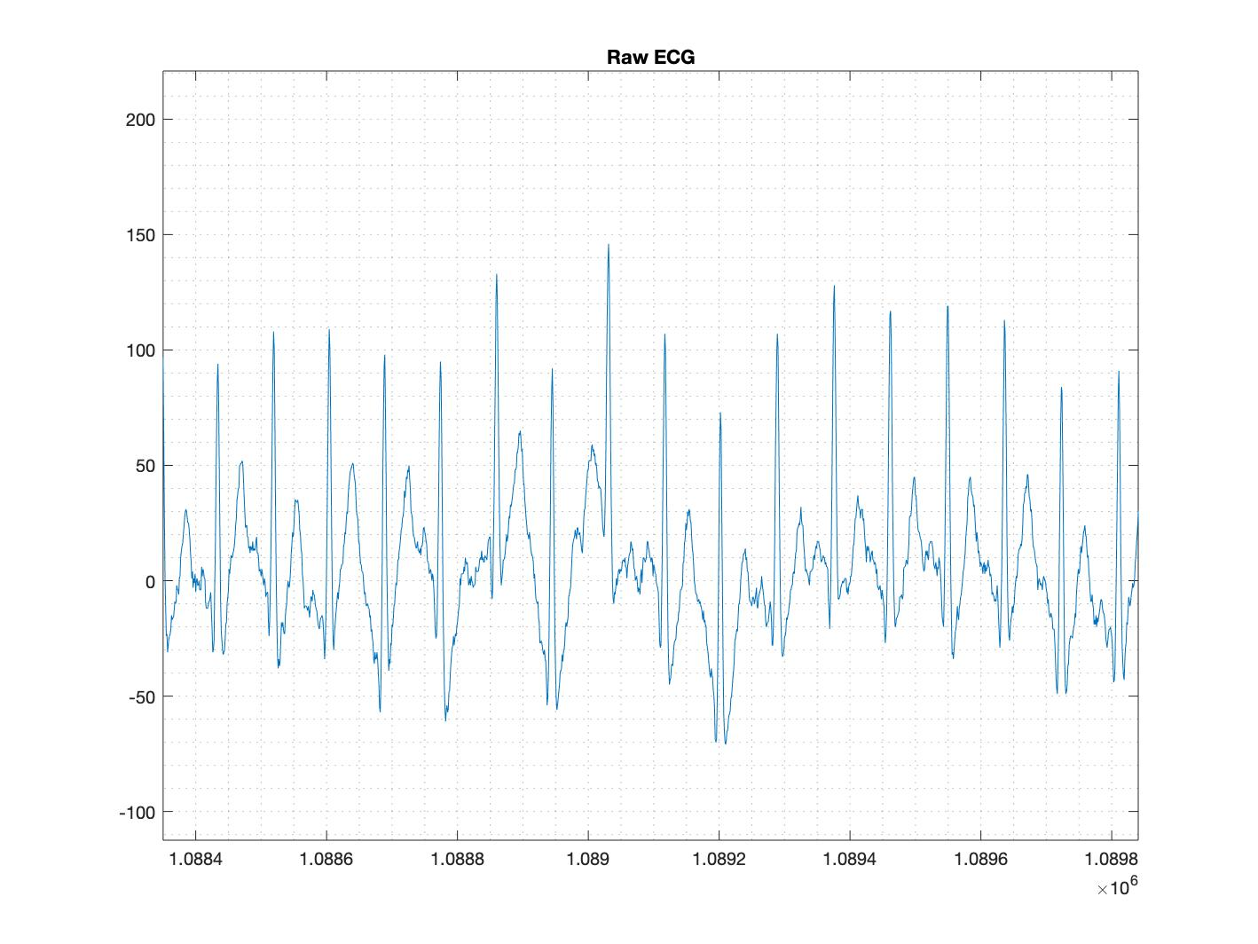
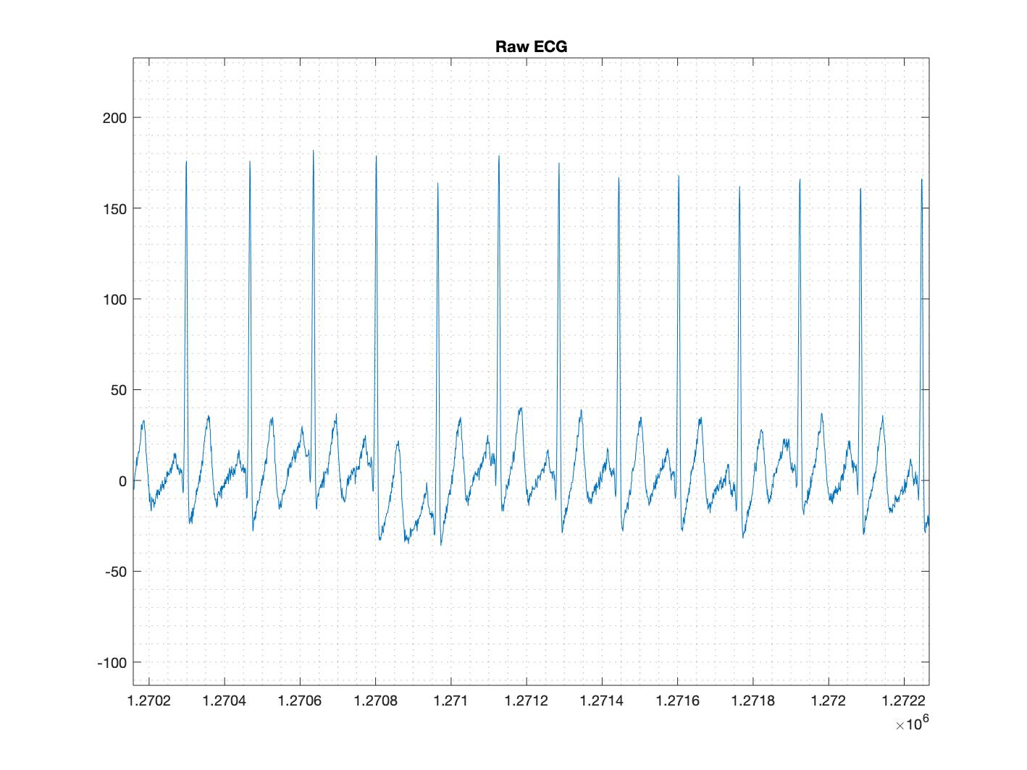
24/02/2020; New Shirt + Electrode Gel

Slide 6
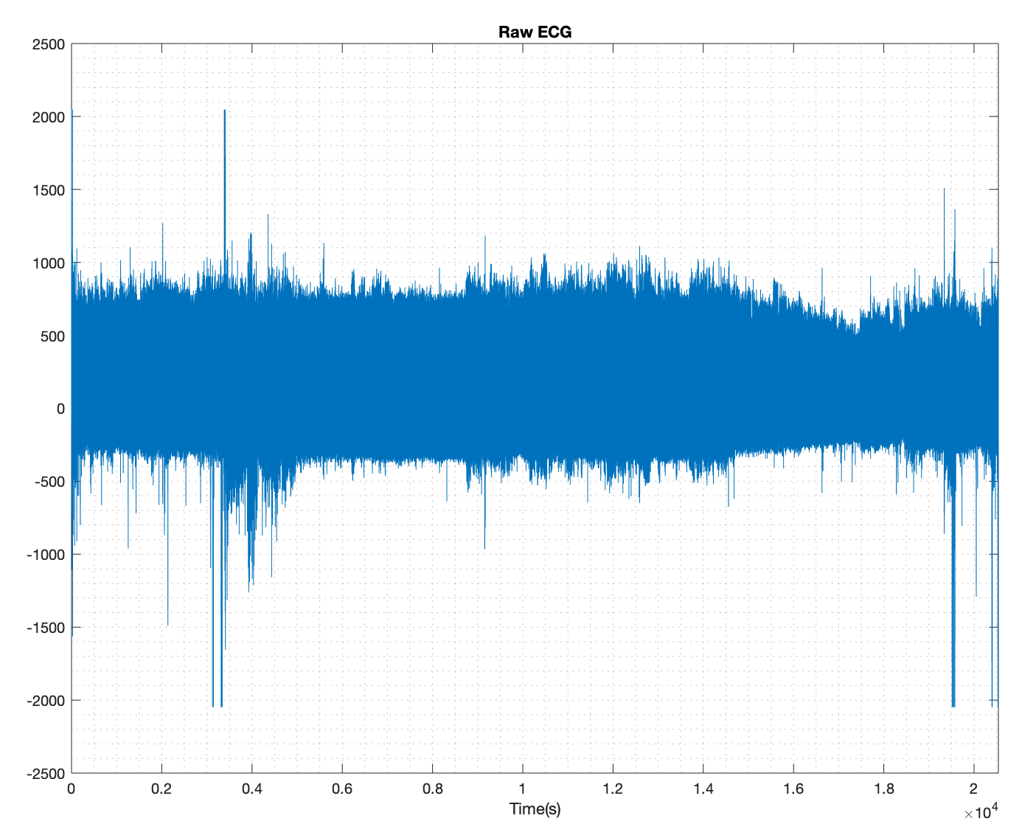
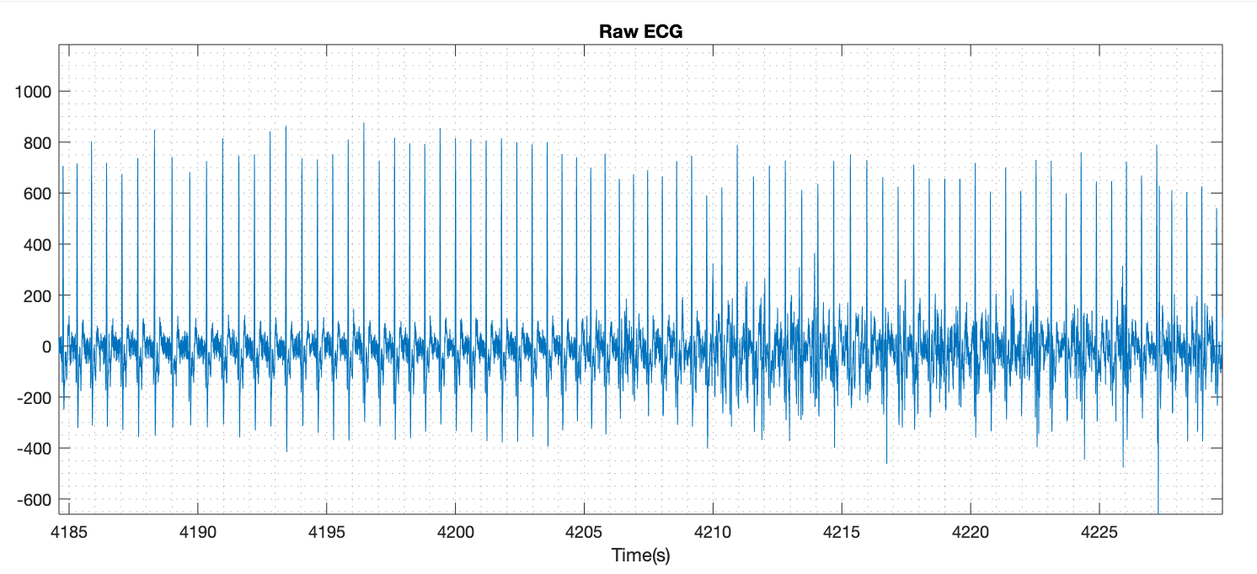
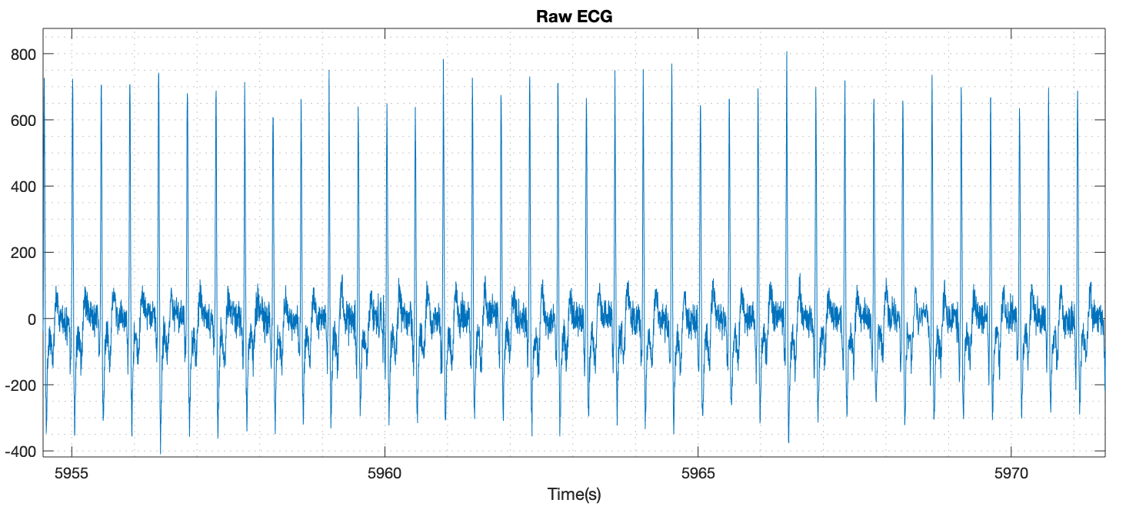
18/02/2020; New Hardware

Slide 7
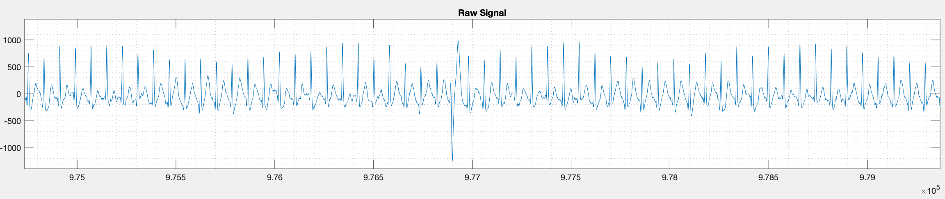
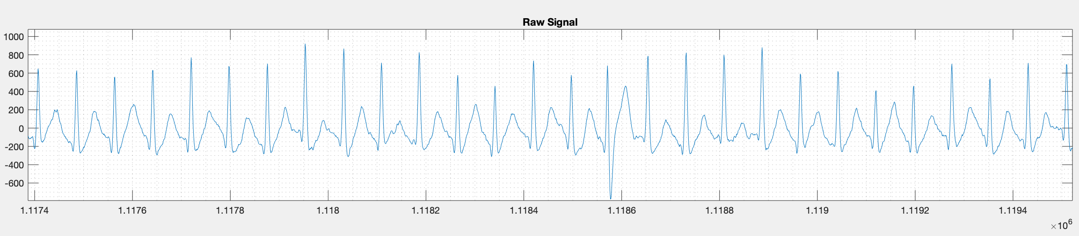
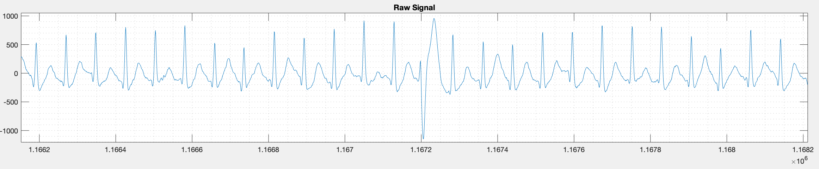
Ectopic heartbeat

Slide 8
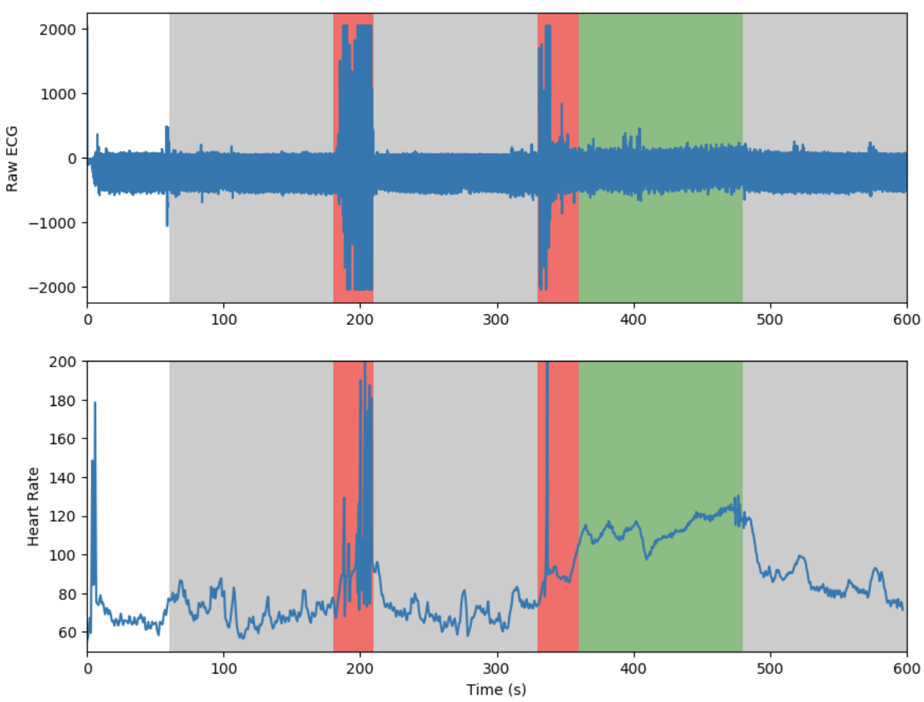

Slide 9
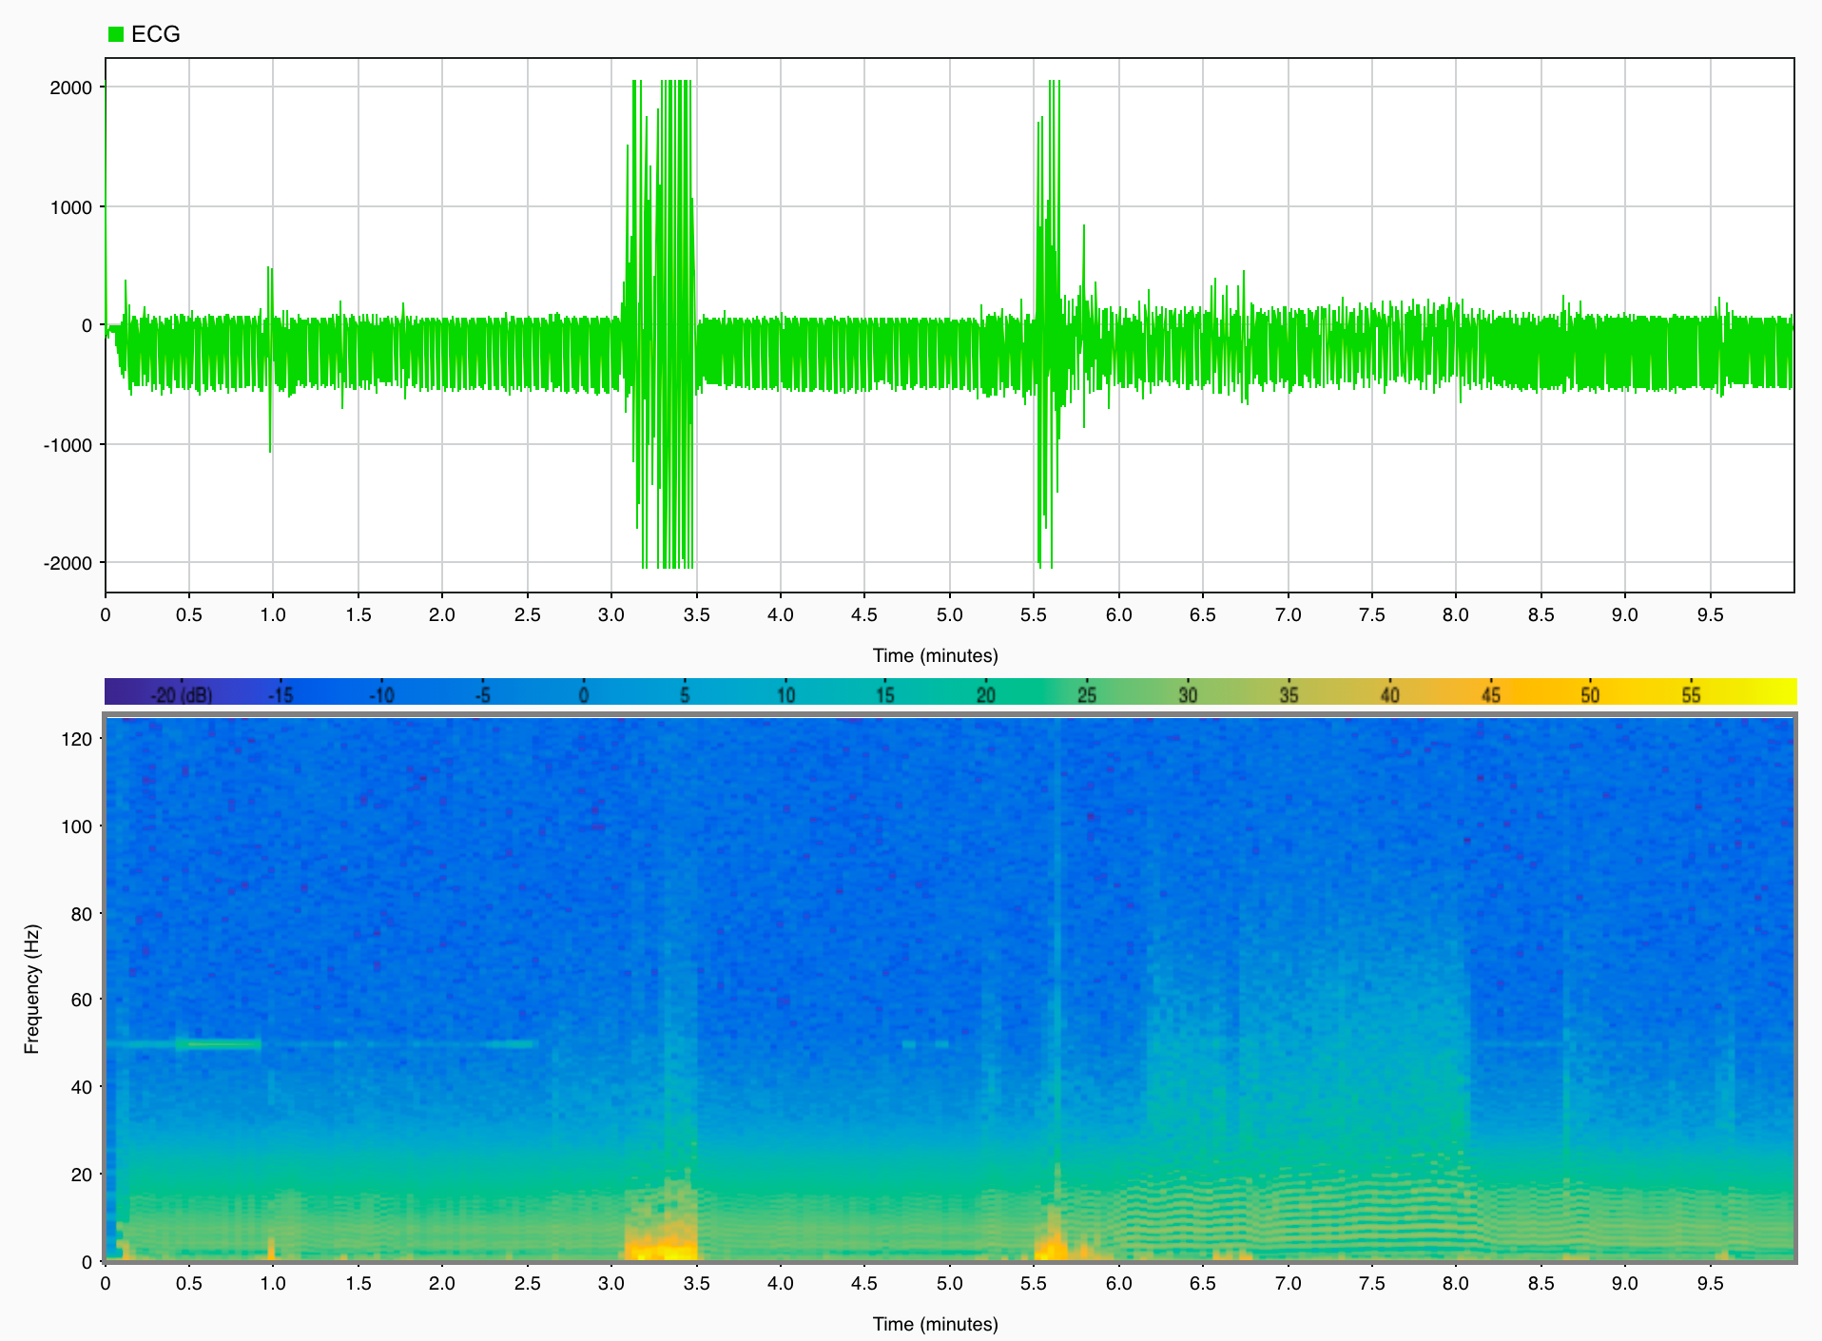

Slide 10
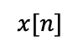
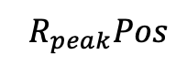
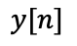
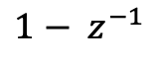
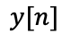
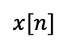
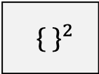
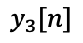
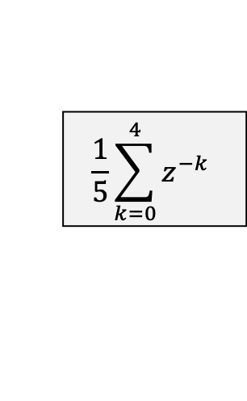
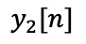
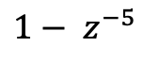
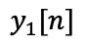
Algorithm (modification)
$$x[n]$$
Pre-Processing Stage
Derivative Derivative Squaring Integral
$$y[n]$$
Detection Stage
R peak detection based
on adaptive threshold
$${ R}_{peak}Pos$$
${\{ \}}^{2}$
$$\frac{1}{5}\sum_{k=0}^{4}{z^{−k}}$$
$$x[n]$$
$${1− z}^{−5}$$
$$y_{1}[n]$$
$${1− z}^{−1}$$
$$y_{2}[n]$$
$$y_{3}[n]$$
$$y[n]$$

Slide 11
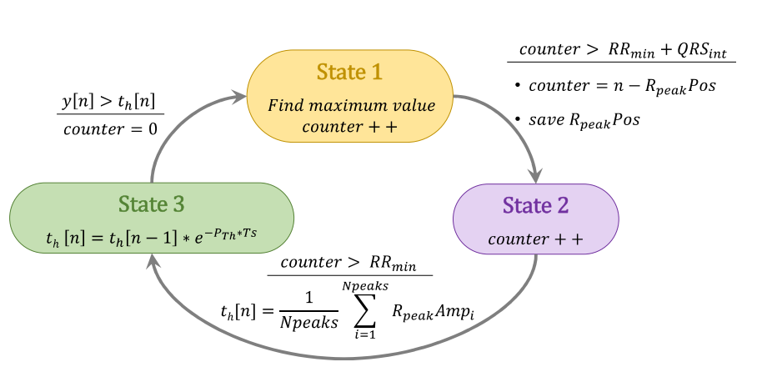
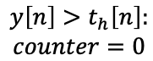
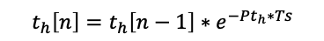
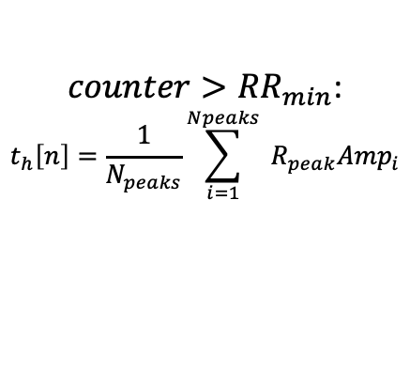
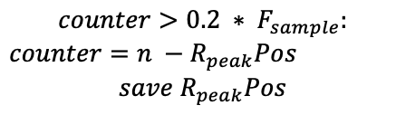
$$y\left[n\right]>t_{h}\left[n\right]:$$
$$counter=0$$
State 1
$$counter>0.2 ∗ F_{sample}:$$
$counter=n −R_{peak}Pos$
$$save{ R}_{peak}Pos$$
Search for R-peak
State 3
State 2
$t_{h}\left[n\right]=t_{h}\left[n−1\right]∗e^{−Pt_{h}∗Ts}$
Counter++
$counter>{RR}_{min}$:
$$t_{h}\left[n\right]=\frac{1}{N_{peaks}}\sum_{i=1}^{Npeaks}{{ R}_{peak}{Amp}_{i}}$$

Slide 12
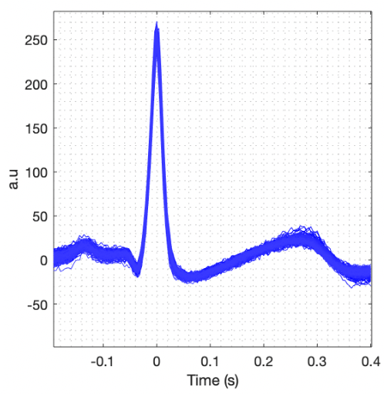
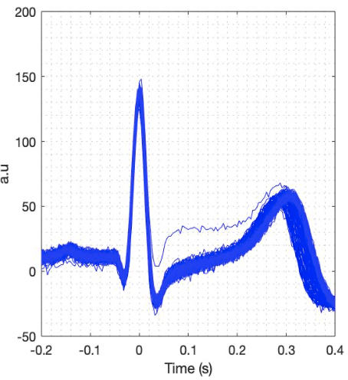
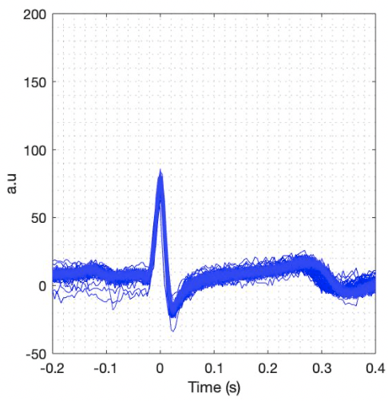
ECG Amplitude
ECG Amplitude
ECG Amplitude

Slide 13
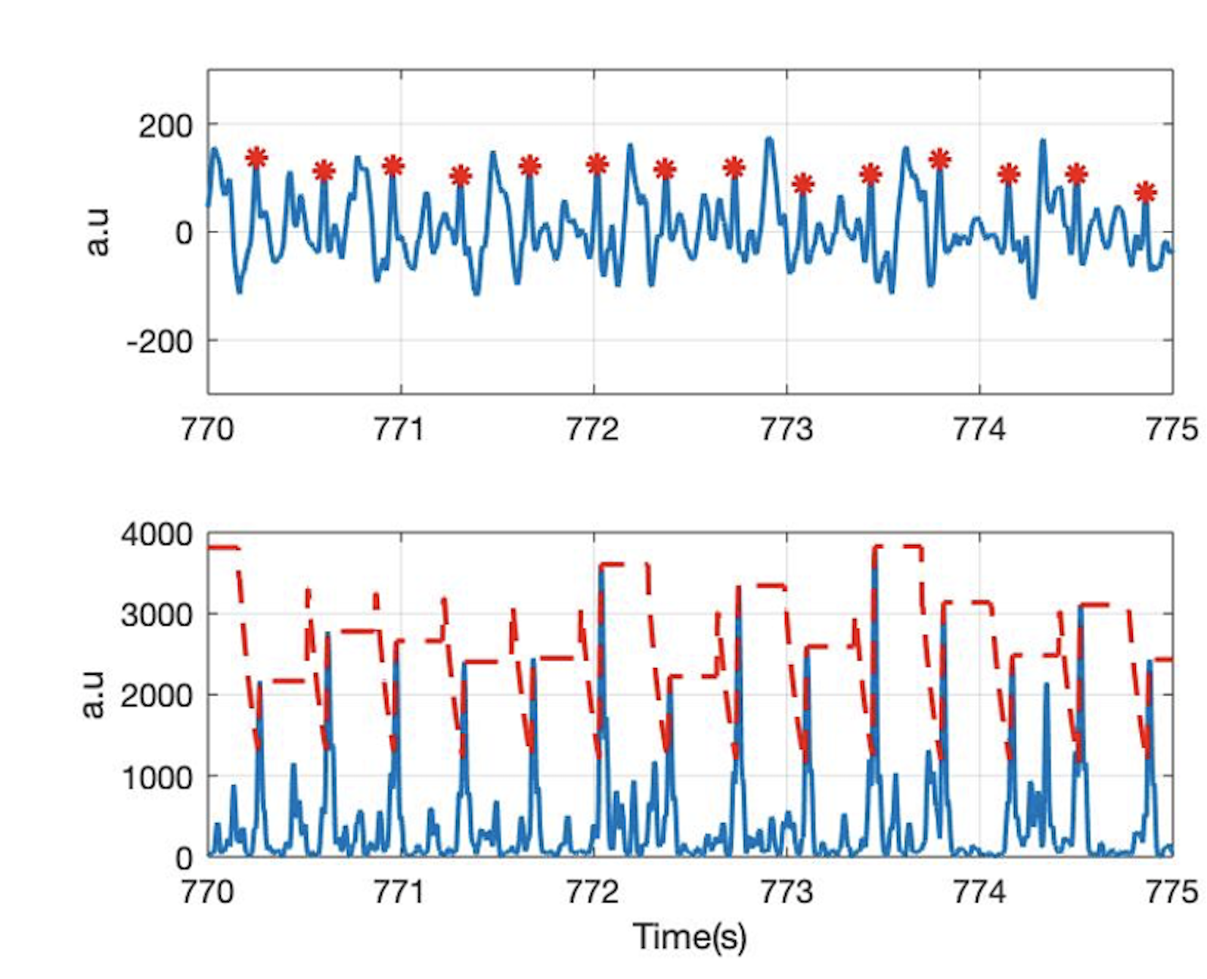
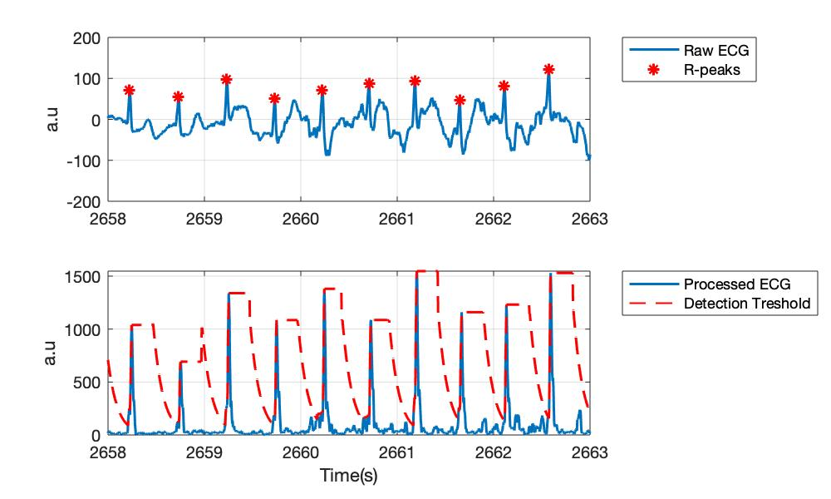
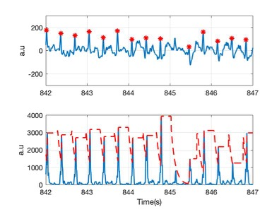
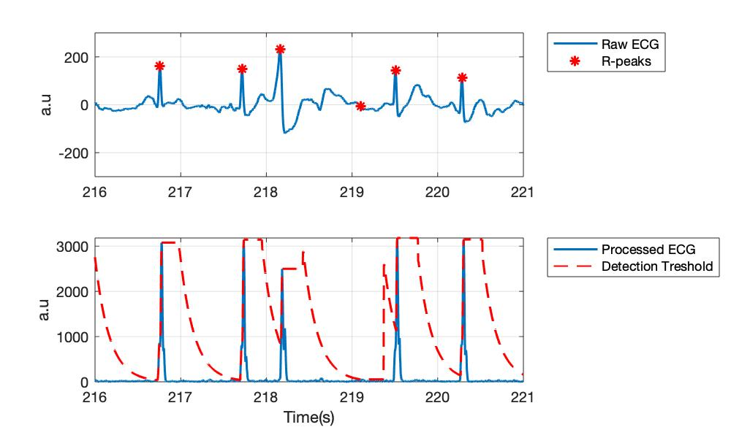
Raw ECG
Processed ECG
Raw ECG
Processed ECG

Slide 14
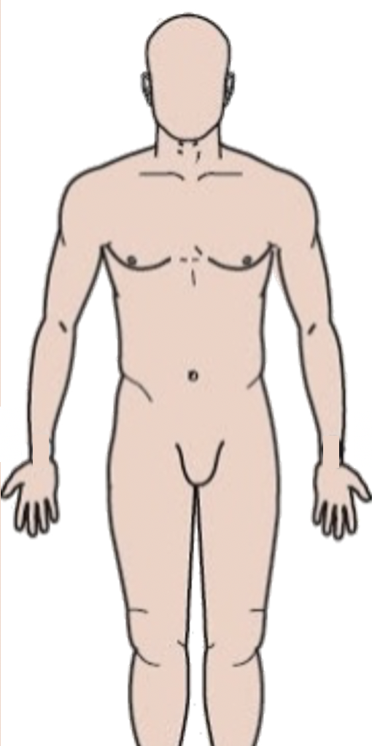

-
+
ECG electrodes
-
+
-
+
ECG electrodes
Shirt version 1
ECG electrodes Shirt version 2

Slide 15
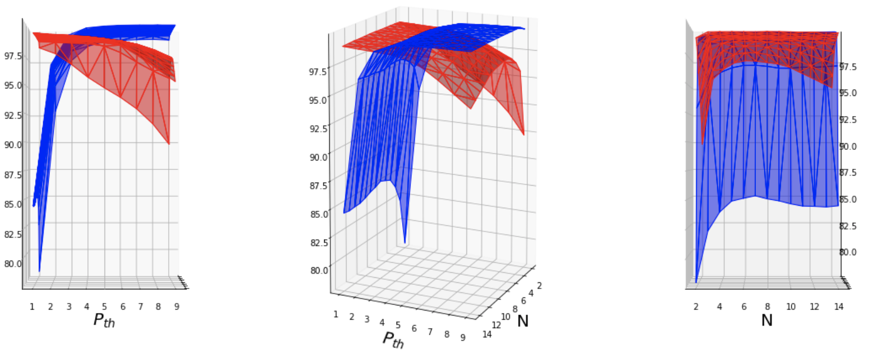
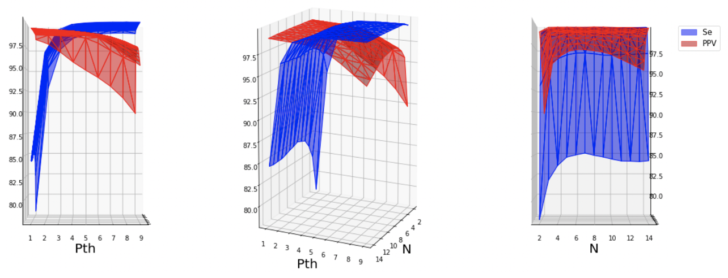

Slide 16
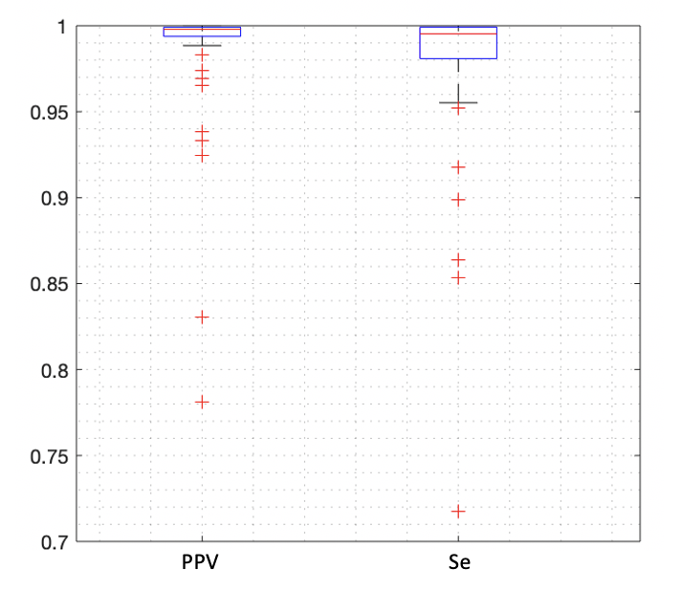

Slide 17
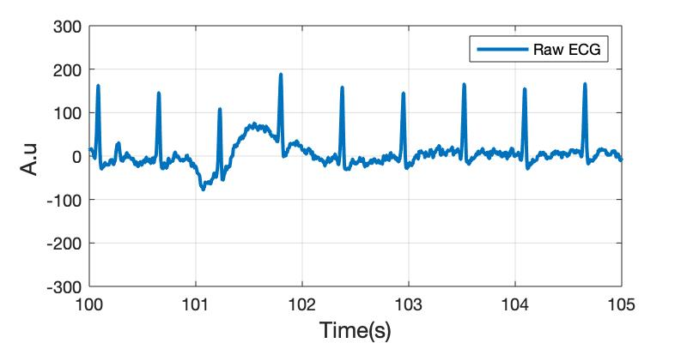
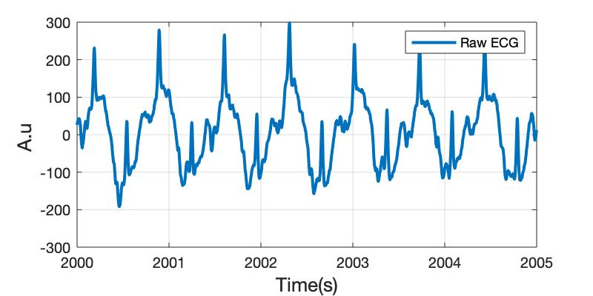




ADC Value
ADC Value
ADC Value
ADC Value
ADC Value
ADC Value

Slide 18

ADC Value
Heart Rate
Time (s)

Slide 19

ADC Value
Heart Rate
Time (s)

Slide 20
Raw ADC value
FIR [2,45]
fir(48, [2,45]/(250/2))

Slide 21



FieldWiz, Shirt Version 1
Noisy ECG
Good Quality ECG
Barely Acceptable
Barely Acceptable
Unacceptable
Unacceptable

Slide 22


FieldWiz, Shirt Version 2
Noisy ECG
Noisy ECG
Good Quality ECG
Good Quality ECG
Barely Acceptable
Barely Acceptable
Unacceptable
Unacceptable

Slide 23


Slide 24


RR-intervals (s)
a.u.
Subspace S₁₂
Subspace S₂₂
a.u.
0
400
800
1200
1600
2000
2400
2800
Subspace S₁₁
Subspace S₂₁
Time (s)

